Slide 1
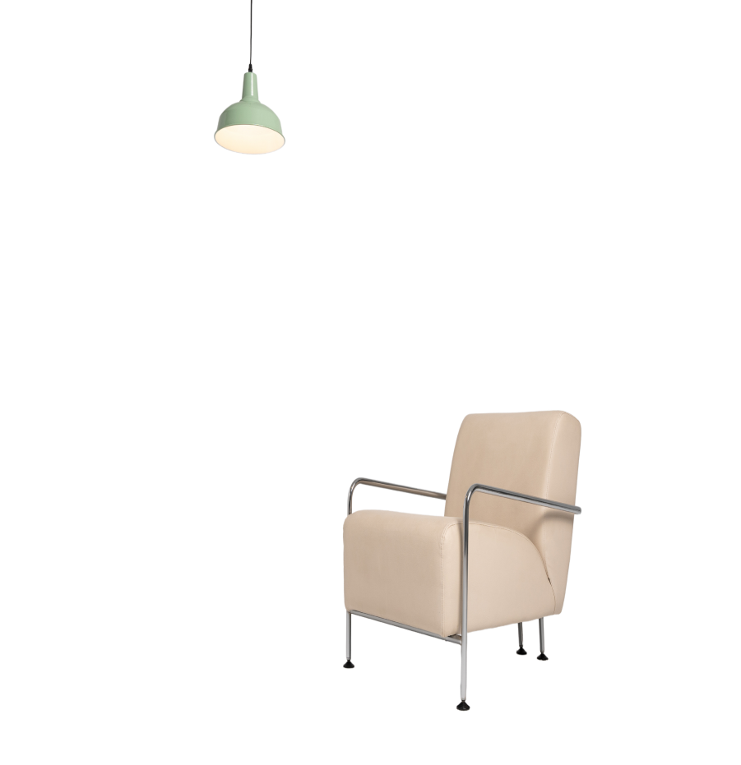






Sarvajanik Education Society Sarvajanik College of Engineering & Technology, Surat. Department of Computer Applications Academic Year: 2025– 26
FurniZone
A Project On
Sahil Dharani (ET24MTCA011)
Kishan Pancholi (ET24MTCA036)
Siya Sachan (ET24MTCA058)
Vidhi Sorathia (ET24MTCA065)
M.C.A. II Sem. 3
Under the Guidance of
Prof. Margee Rawal
2025 | Comfort come first…

Slide 2



Table Of Content
01
02
03
04
05
Introduction
Project Profile
System Environment
Why FurniZone?
Types of Furniture
06
07
08
09
FurniZone Overview
Customer Service and Support
Future Plans and Innovations
References

Slide 3
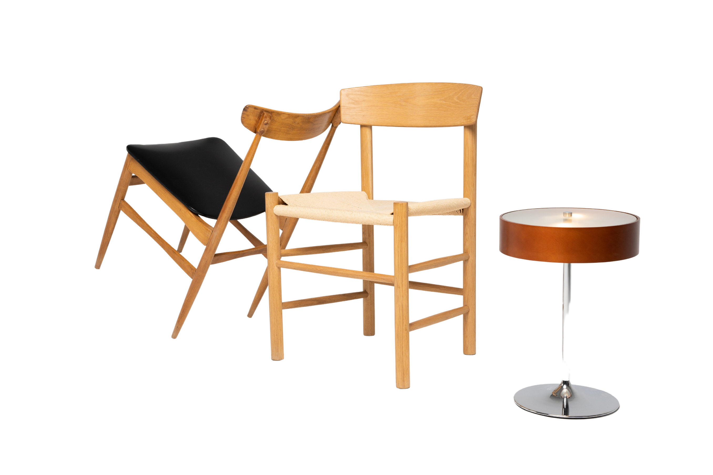
INTRODUCTION
At [Your Furniture Website Name], we believe that furniture isn't just about functionali
At FurniZone, we believe that furniture isn't just about functionality—it's about creating spaces that inspire, comfort, and reflect your unique style. Whether you're furnishing your home, office, or any other space, we're here to help you turn your vision into reality., comfort, and reflect your unique style. Whether you're furnishing your home, office, or any other space, we're here to help you turn your vision into reality.
Whether you're searching for a statement sofa, a cozy dining set, or stylish accents to complete your decor, we invite you to explore our diverse range of collections. With options to suit every taste and budget, there's something for everyone at FurniZone.
Shop with confidence knowing that your satisfaction is our top priority. With secure online ordering and hassle-free returns, we're committed to making your shopping experience as enjoyable as possible.

Slide 4

Project Profile
Front End | Kotlin, Android Studio
Back End | PHP , MySQL
Development Tool | VS Code, Android Studio, MS Word, MS Vision
Application Server | Xampp Server
Project Guide | Prof. Margee Rawal
Developed by | Sahil Dharani (ET24MTCA011) Kishan Pancholi (ET24MTCA036) Siya Sachan (ET24MTCA058) Vidhi Sorathia (ET24MTCA065)

Slide 5
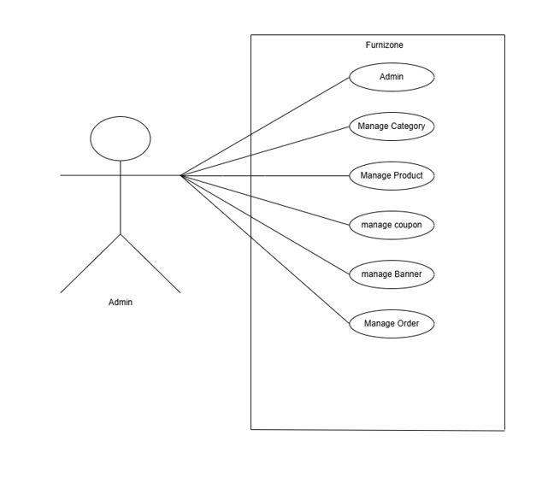
USE CASE DIAGRAM
ADMIN SIDE :

Slide 6
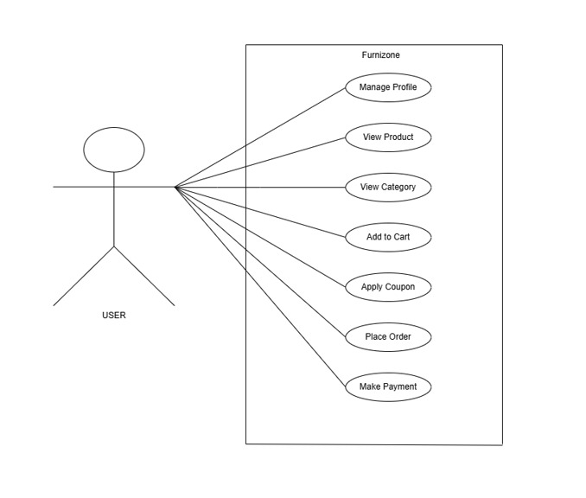
USE CASE DIAGRAM
USER SIDE :

Slide 7
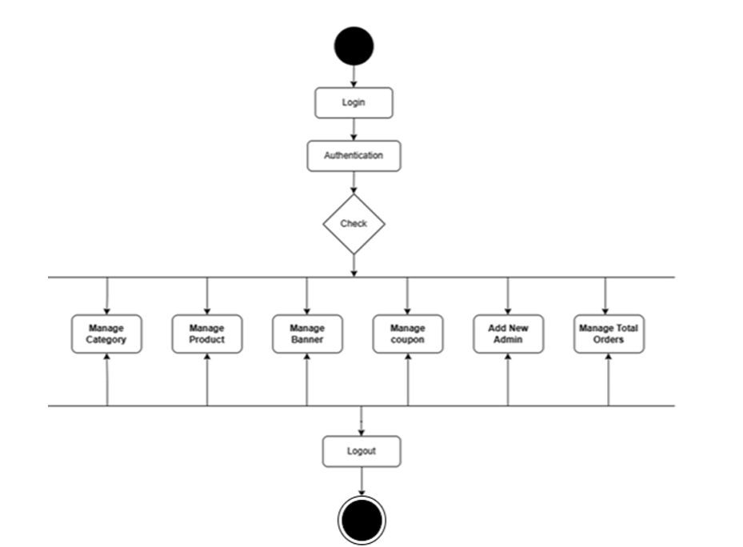
ACTIVITY DIAGRAM
ADMIN SIDE:

Slide 8
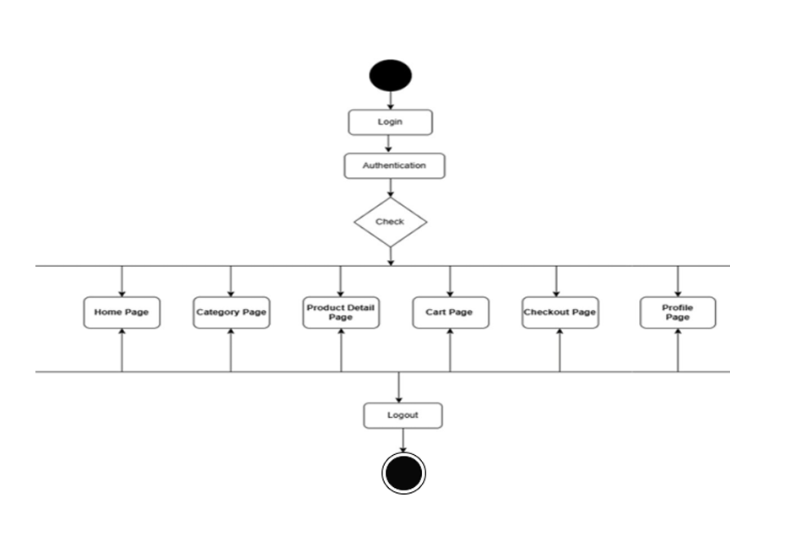
ACTIVITY DIAGRAM
USER SIDE:

Slide 9
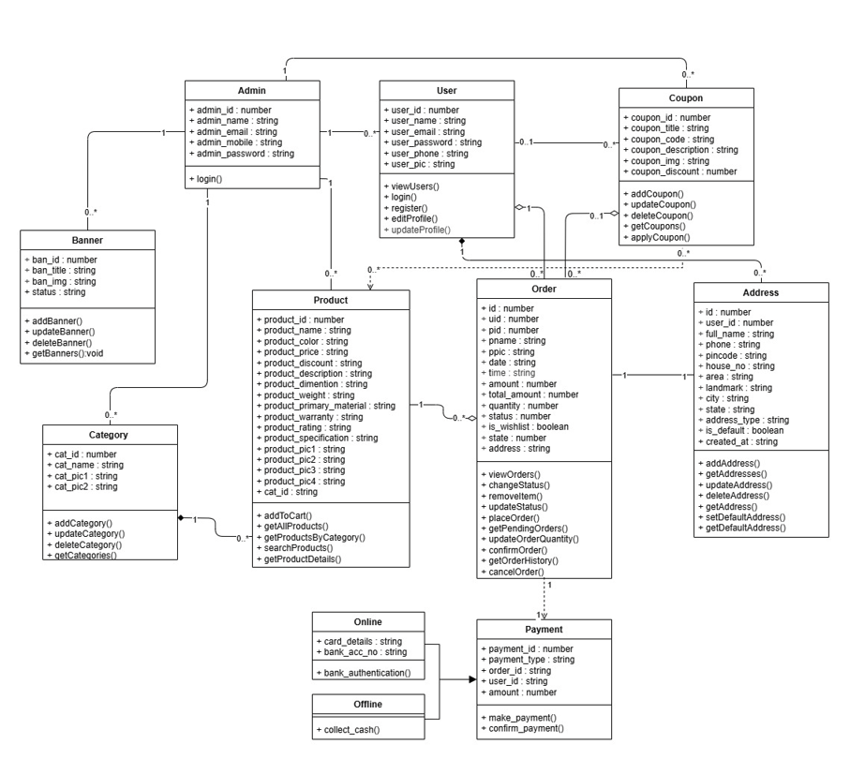
CLASS DIAGRAM:

Slide 10
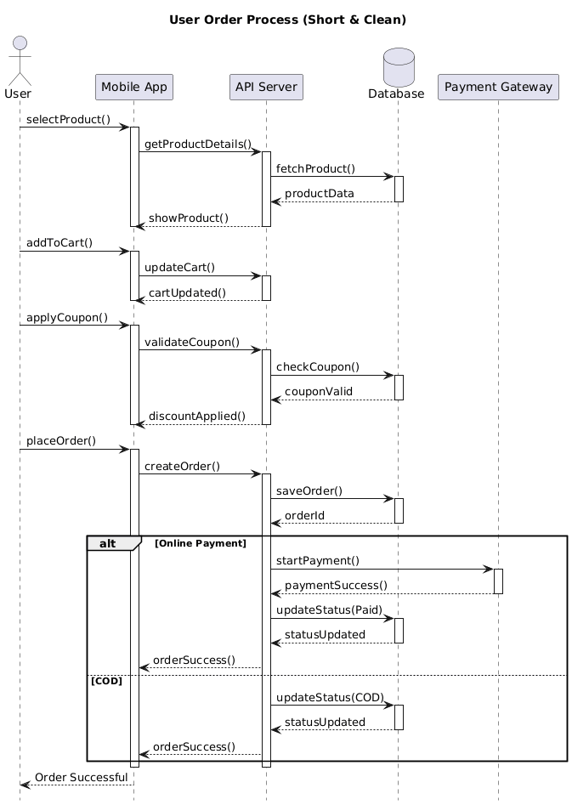
INTERACTION DIAGRAM:

Slide 11
External API Documentation :
API / Service | Purpose | How It Works | Used In
India Postal Pincode API | Auto-location fill | When user enters PIN code, API returns city & state so user doesn’t need to type manually | Address Add Screen
Razorpay Payment Gateway API | Secure online payment | Provides UPI, Card, Netbanking, Wallet payment methods for completing orders digitally | Payment Page

Slide 12
Internal API Documentation :
File Name | Detailed Description
register.php | Creates a new user account. Validates basic details like name, email, phone, password and stores them in DB. Returns success/failure response.
login_api.php | Authenticates user using email/phone + password. On success returns user profile, id, session-related data to enter the app.
get_user_details.php | Fetches complete profile information of logged-in user such as name, email, phone, address, profile pic etc.
editprofileapi.php | Allows modification of user details. Used when user edits profile inside app setting.
update_profile.php | An alternate API mainly used to update profile fields like name/image/phone without affecting authentication.
userapi.php | General user management API (often used by admin or backend) to fetch or update user details globally.
address_add.php | Adds a new address entry for a user including house no, street, city, zip, landmark etc.
address_get.php | Retrieves all saved addresses of the user, used inside address selection page.
address_get_single.php | Fetch only one specific address using address ID – helpful when editing.
address_update.php | Updates an existing address record selected by user.
address_delete.php | Deletes a saved address permanently from database.
address_set_default.php | Marks selected address as primary/default. Only one default allowed per user.
address_get_default.php | Used during checkout to automatically fetch default delivery address.

Slide 13
File Name | Detailed Description
category.php | Returns complete list of product categories displayed on home screen.
sub_catapi.php | Fetches sub-categories according to selected parent category.
prod_from_cate_api.php | Returns list of products based on category/filter. Supports pagination/search.
searchApi.php | Searches products globally using text keywords – used in search bar feature.
bannerapi.php | Fetches banner images for slideshow/carousel on homepage. Helps in promotions.
getDiscountApi.php | Provides discount values or offers related to selected products or carts.
add_orderapi.php | Creates a new order record after user places order from cart. Stores item list, price, payment status, address.
confirm_order_api.php | Confirms order once placed. Usually triggered after payment success or final review.
cancel_order_api.php | Cancels order requested by customer. Updates status & restores inventory if needed.
removeOrder.php | Deletes or force removes order entry. Usually admin-level functionality.
getorder_api.php | Returns current/active orders placed by user including status like packed/shipped/delivered.
order_history_api.php | Fetches past completed or cancelled orders for history section inside profile.
updateqtyapi.php | Updates quantity for order or cart items. Handles increment/decrement stock logic.
coupen.php | Validates coupon code input by user. Returns discount price, applicable items, expiry check etc.

Slide 14

Why FurniZone?
Step into the world of FurniZone and discover a vast array of furniture options designed to elevate your living and working environments. From elegant living room sets to cozy bedroom essentials, ergonomic office solutions to outdoor oasis inspirations, our curated collection offers something for every taste and preference. With a diverse range of styles, materials, and designs to choose from, you'll find inspiration at every turn.

Slide 15


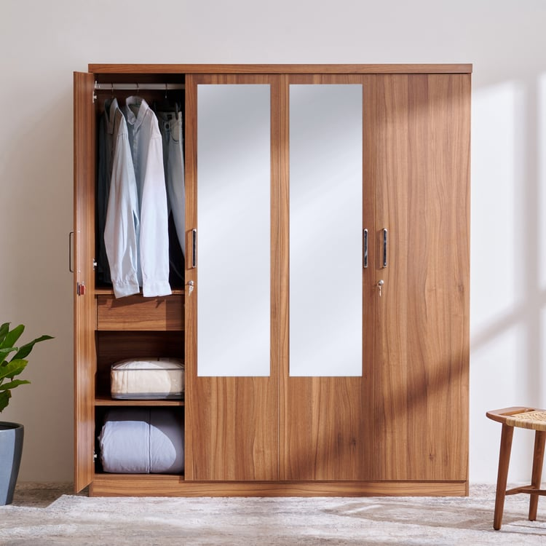

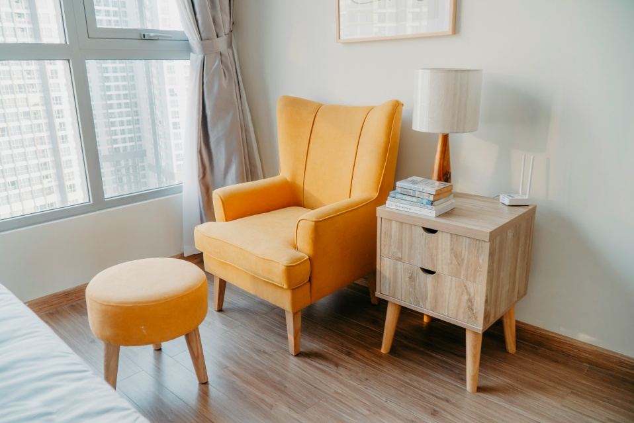
Types of furniture's in FurniZone
.
Sofa
Bed
Chairs
Wardrobe

Slide 16
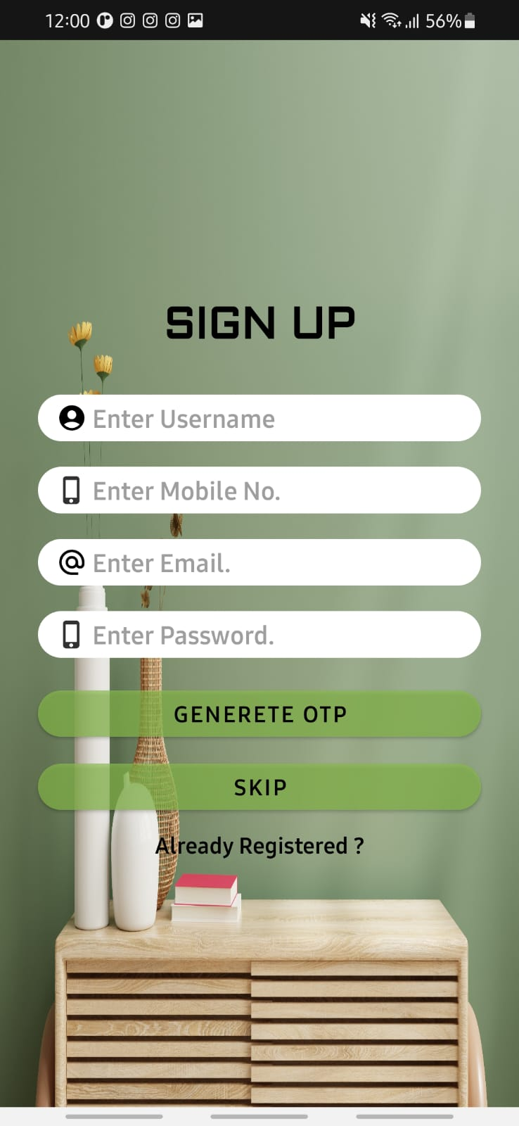
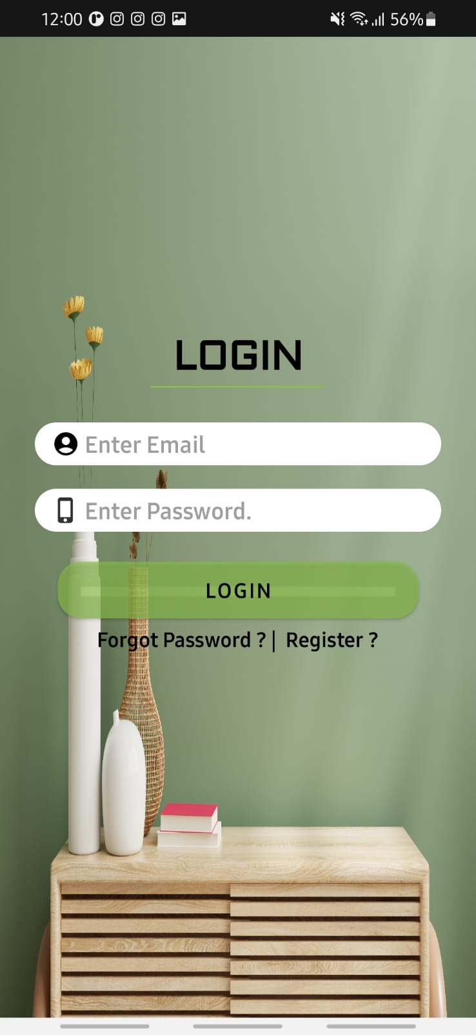
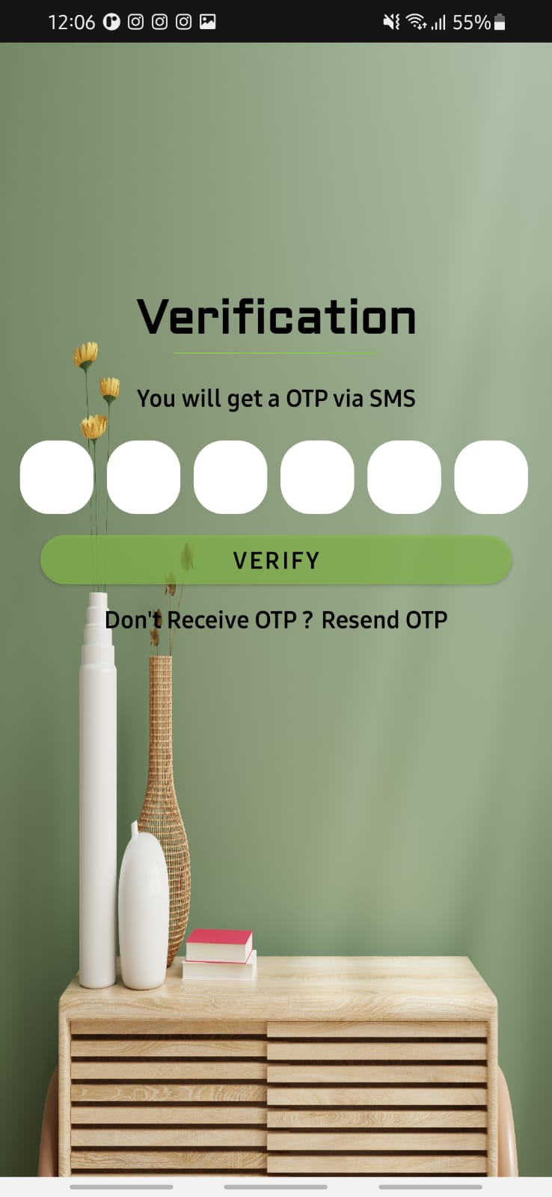
FurniZone Overview
.

Slide 17
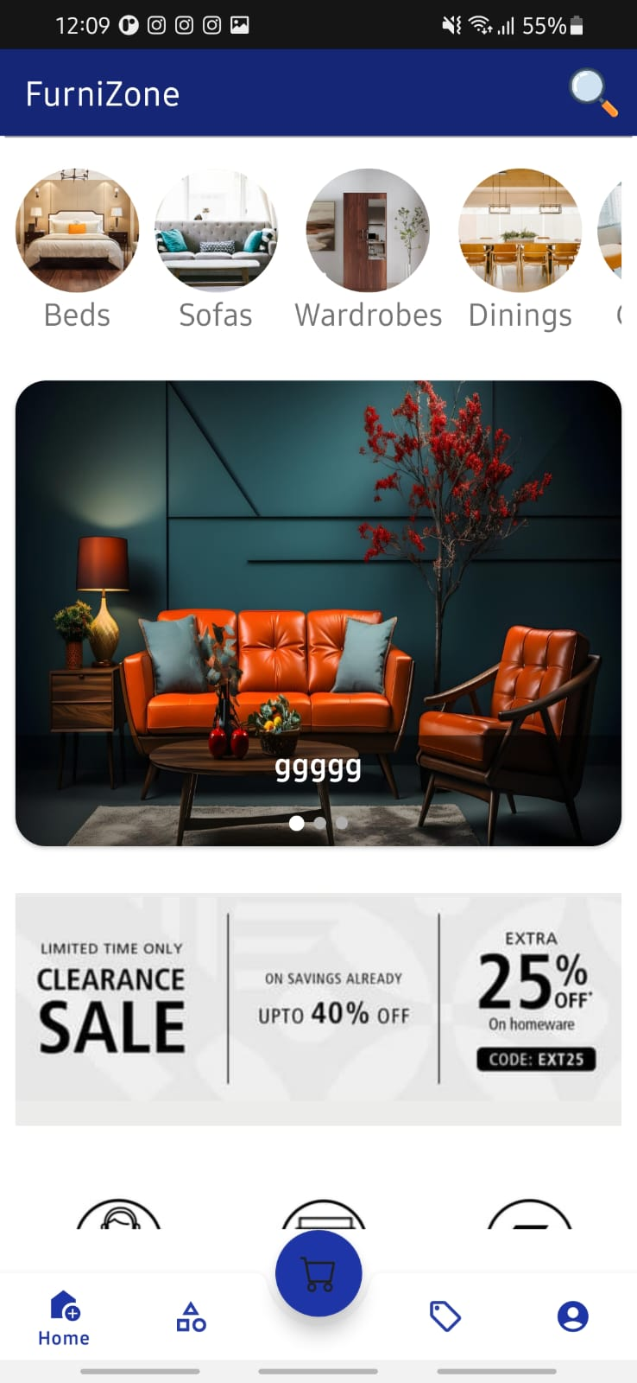
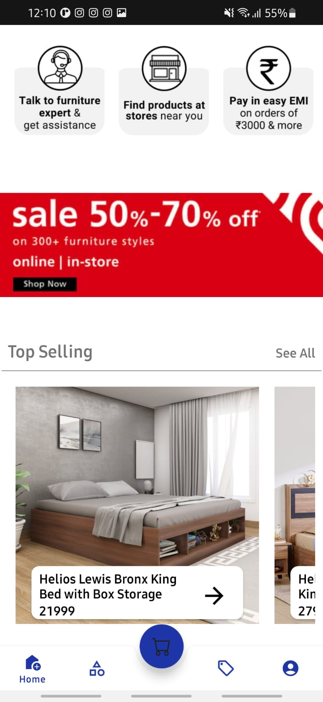
Home Slide
.

Slide 18
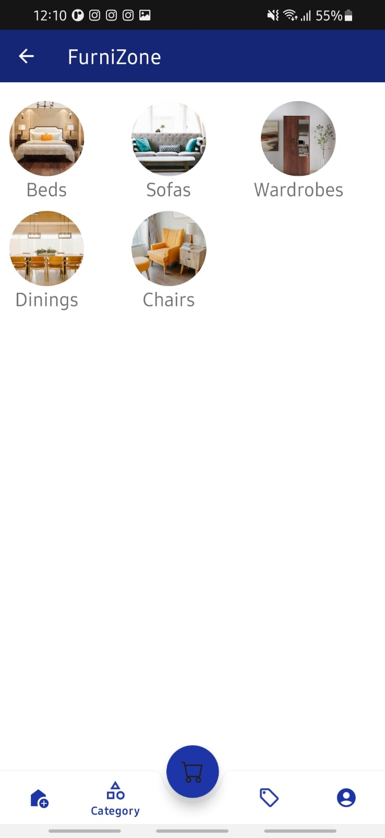
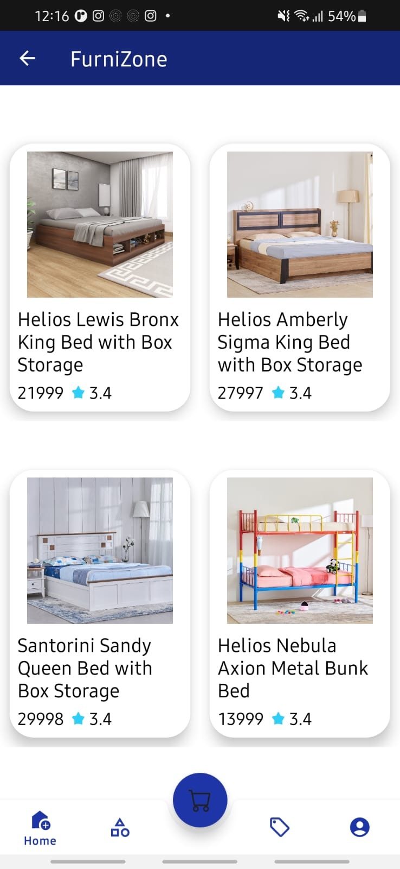
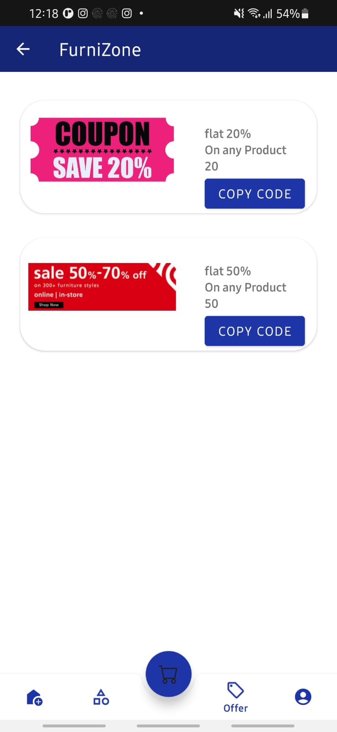
Category , Product and Offer slide
.

Slide 19
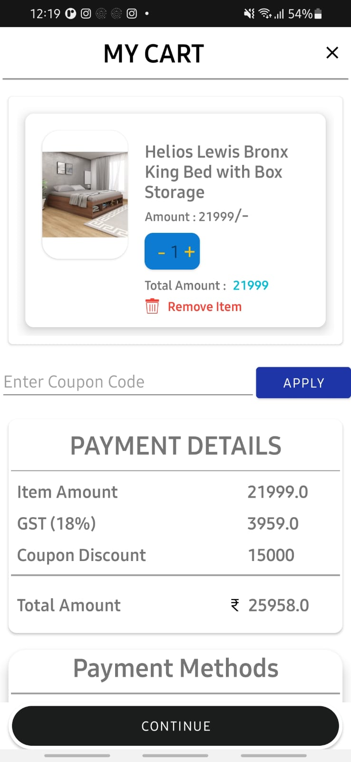
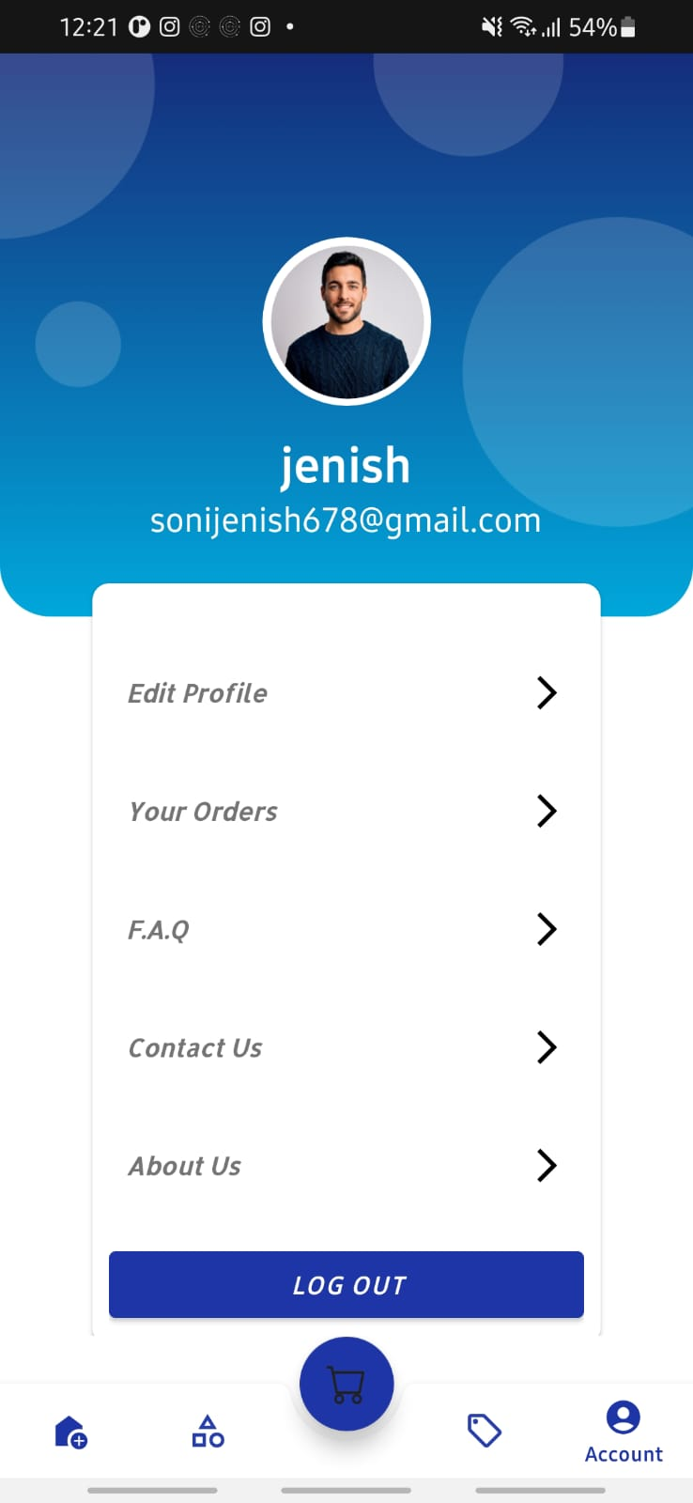
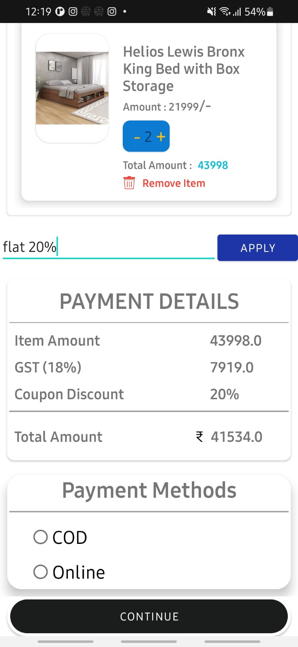
Cart , Payment method and Profile slide
.

Slide 20
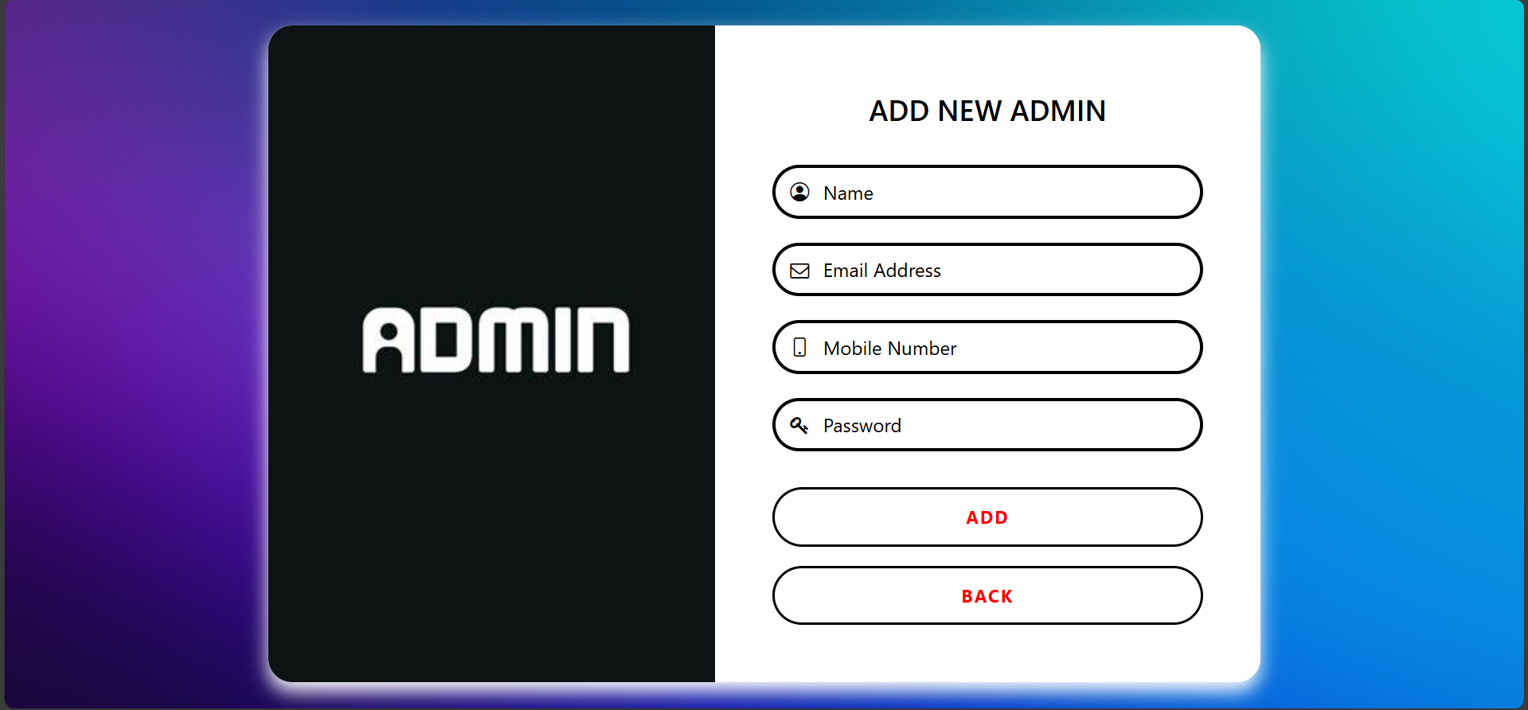
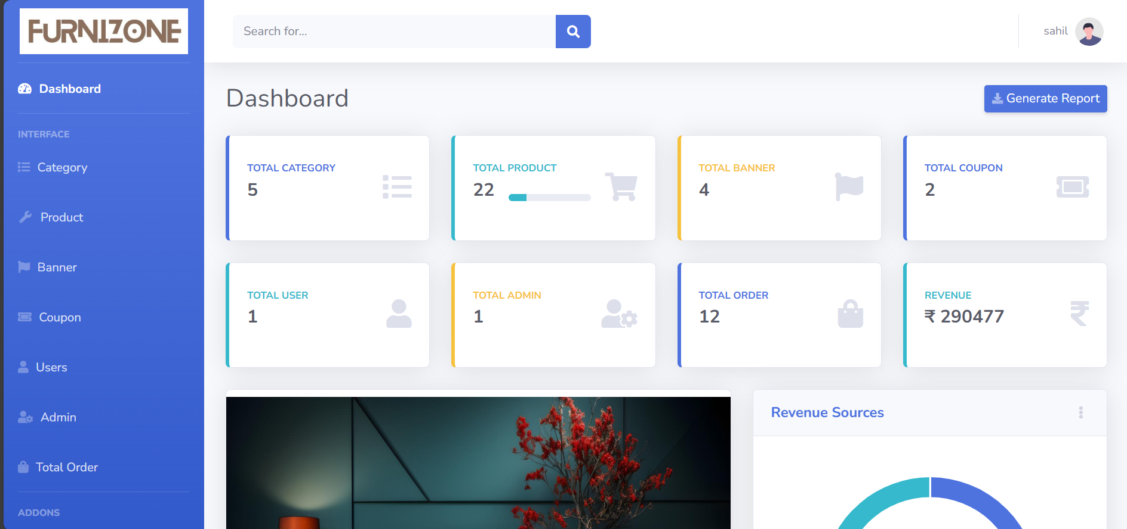
Admin and Dashboard
.

Slide 21
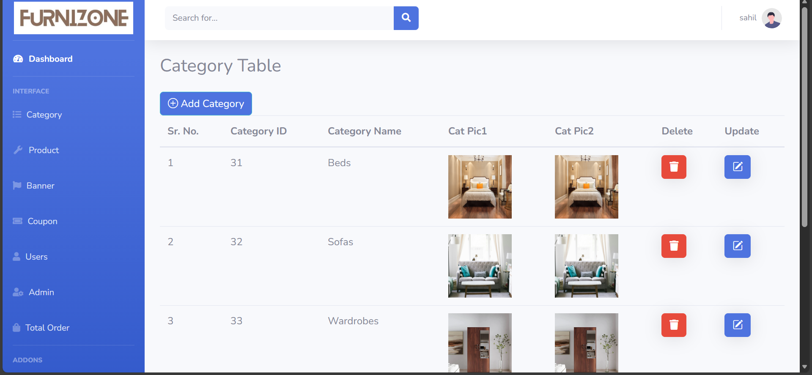
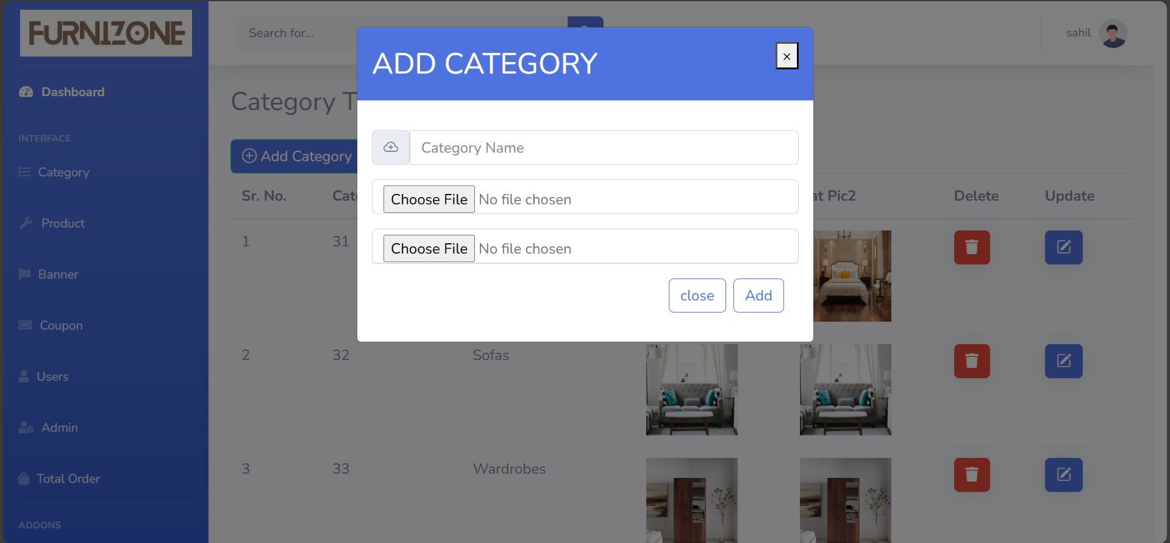
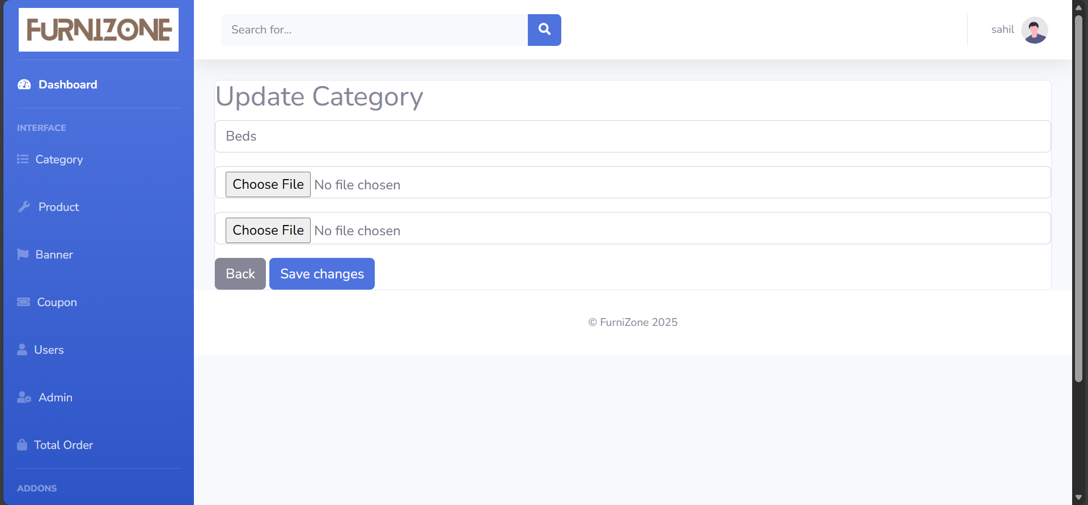
Category
Add Category
.
Update Category

Slide 22
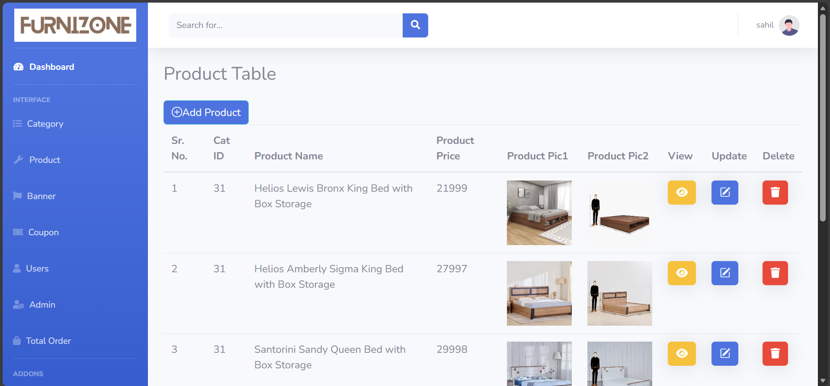
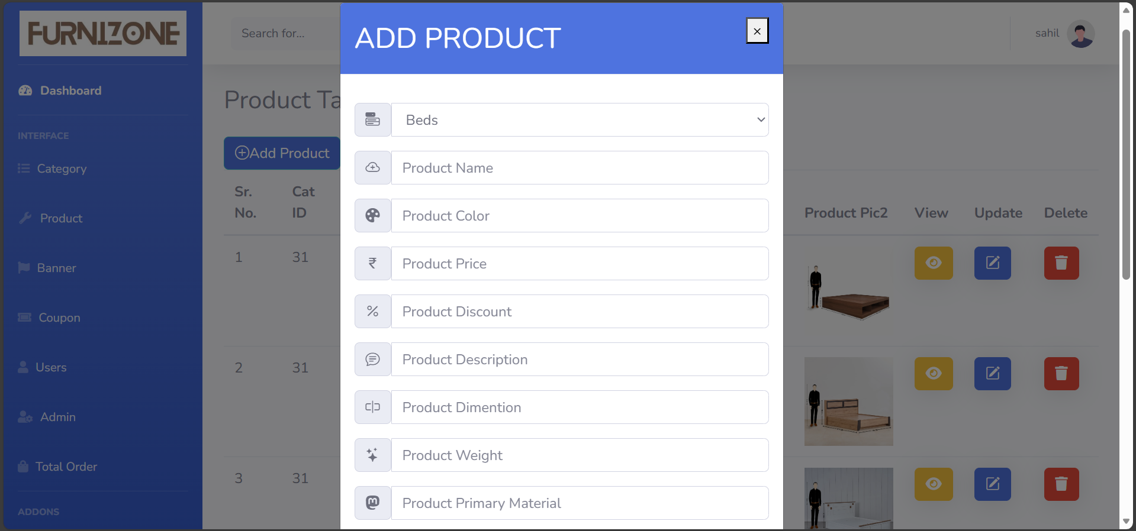
Product
Add Furniture

Slide 23
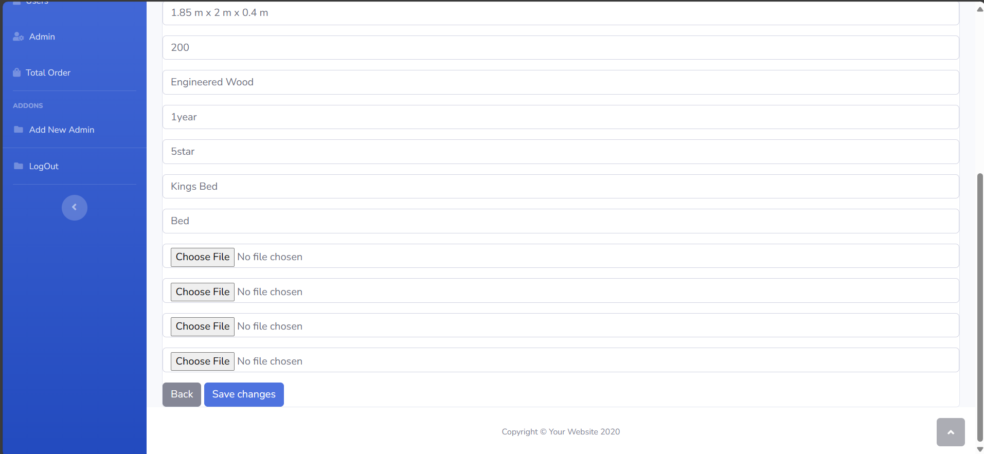
Update Product

Slide 24
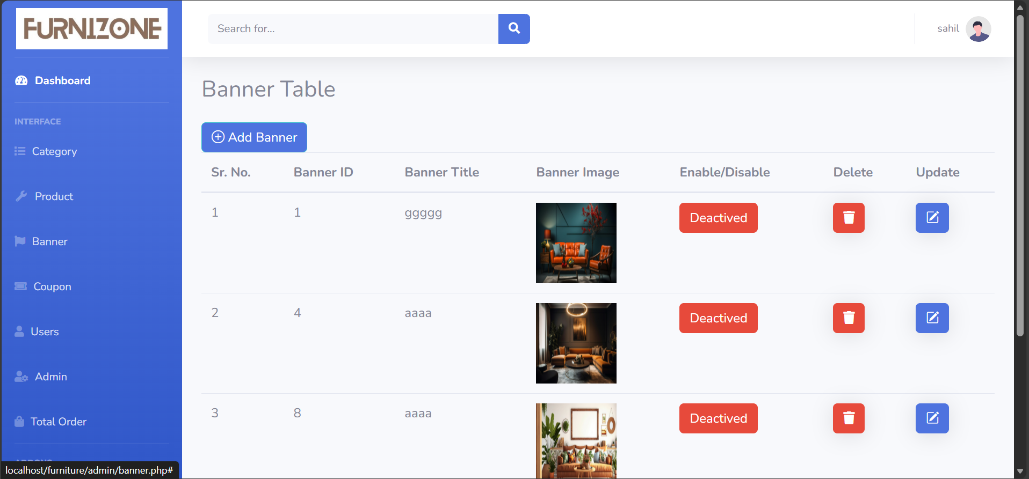
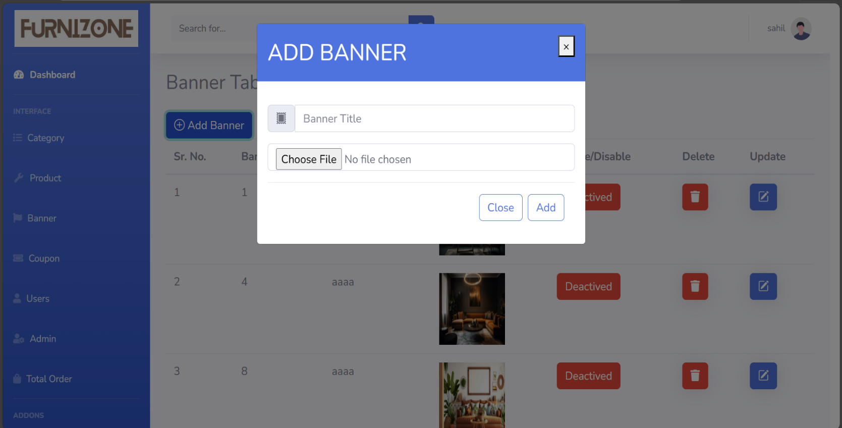
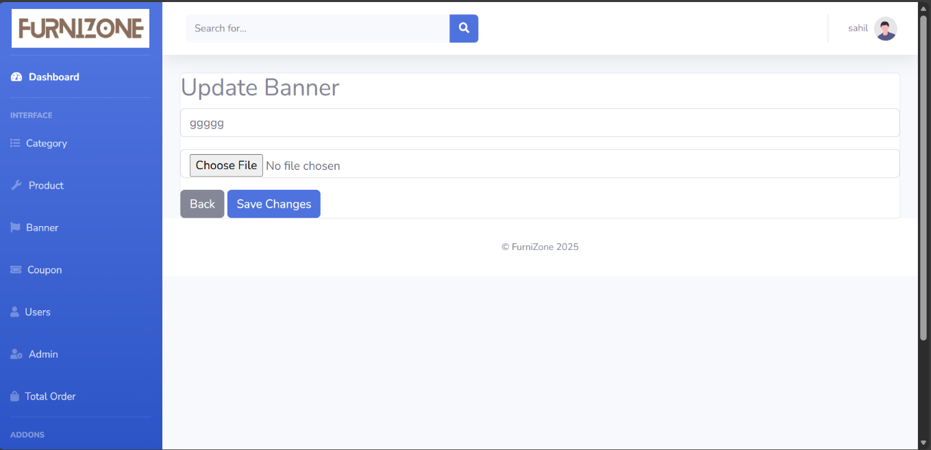
Banner
Update Banner
Add Banner

Slide 25
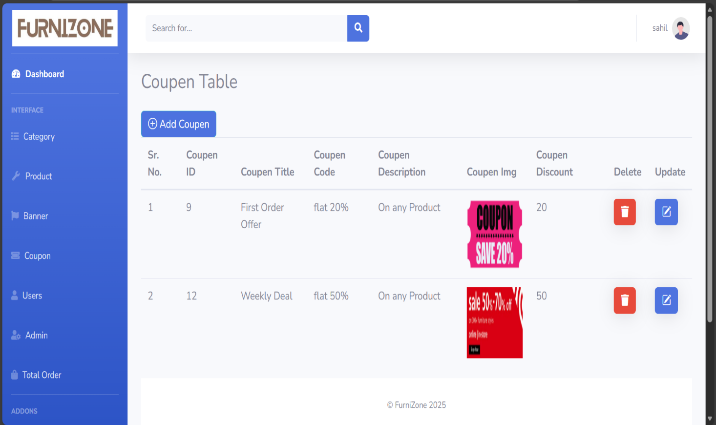
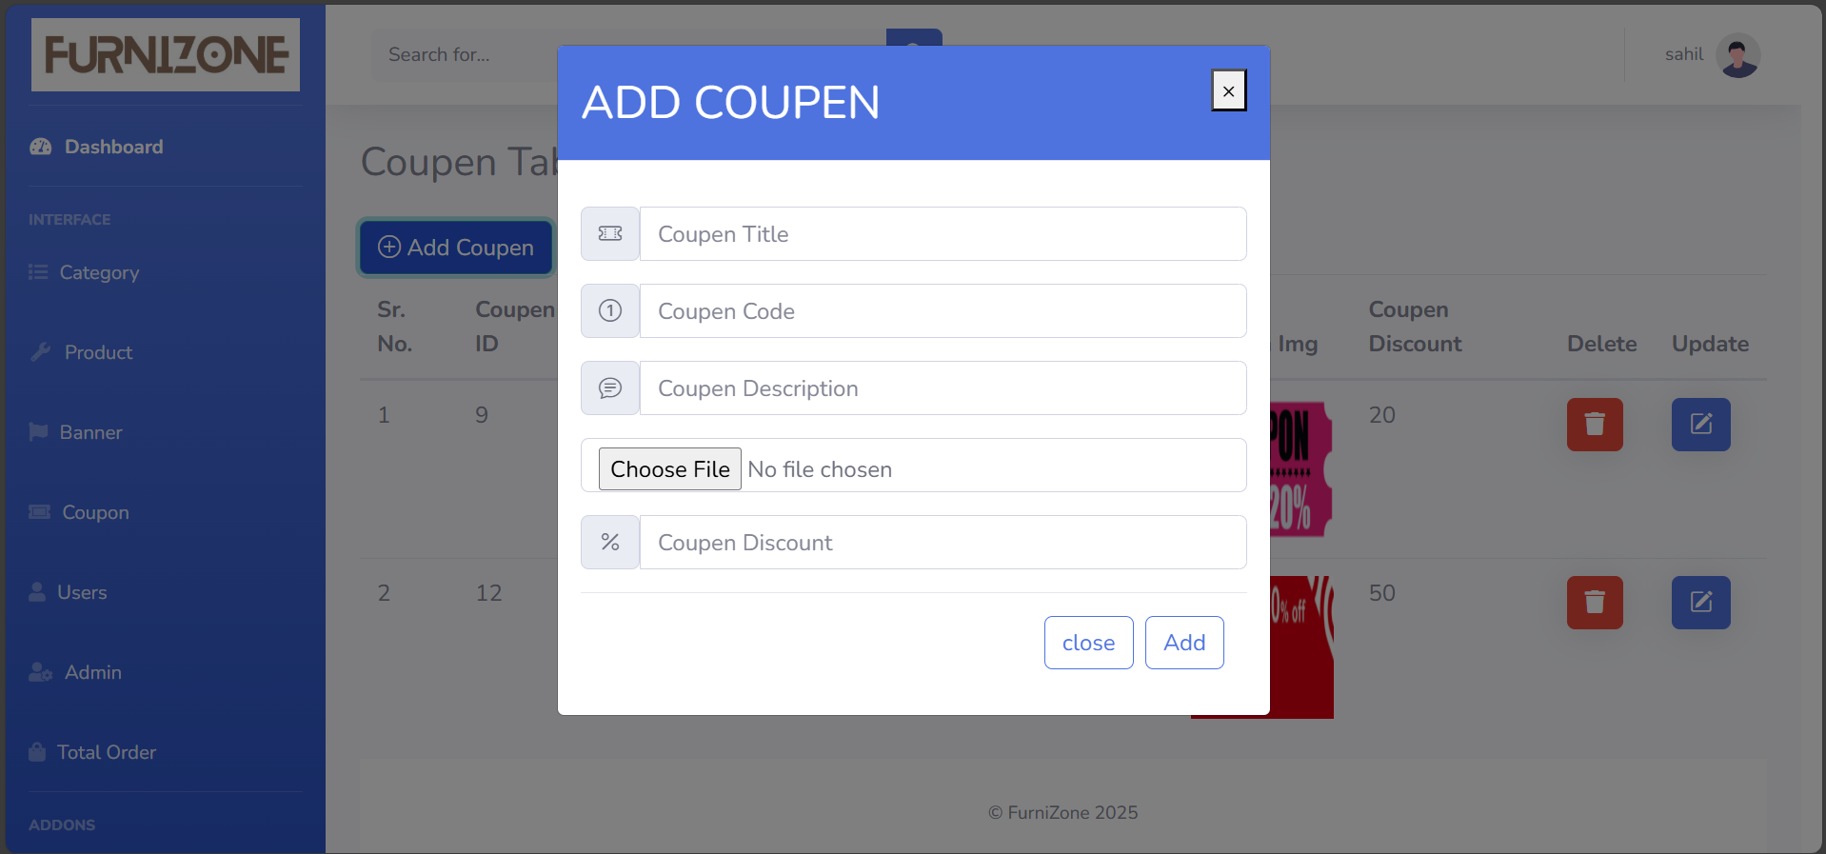
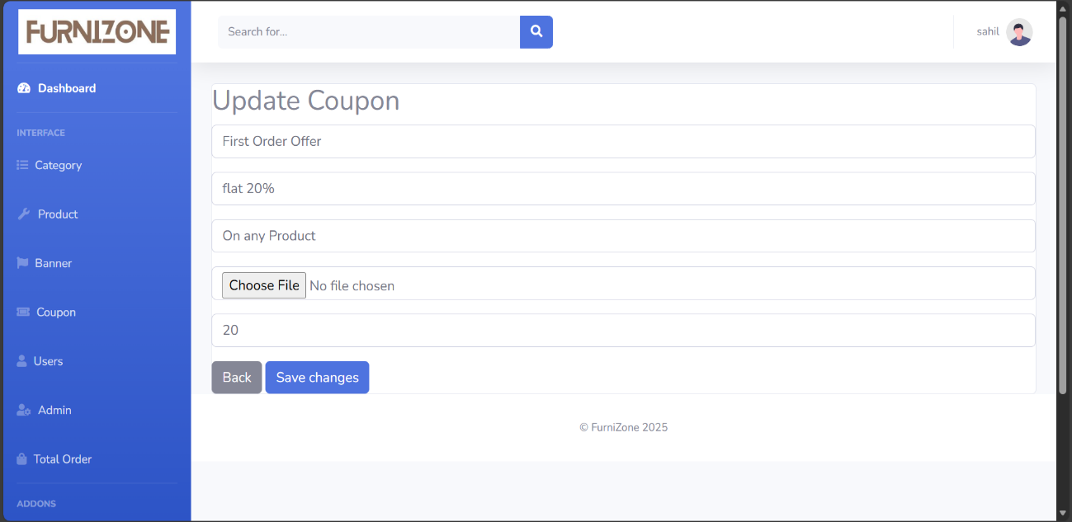
Coupon
Update Coupon
Add Coupon

Slide 26
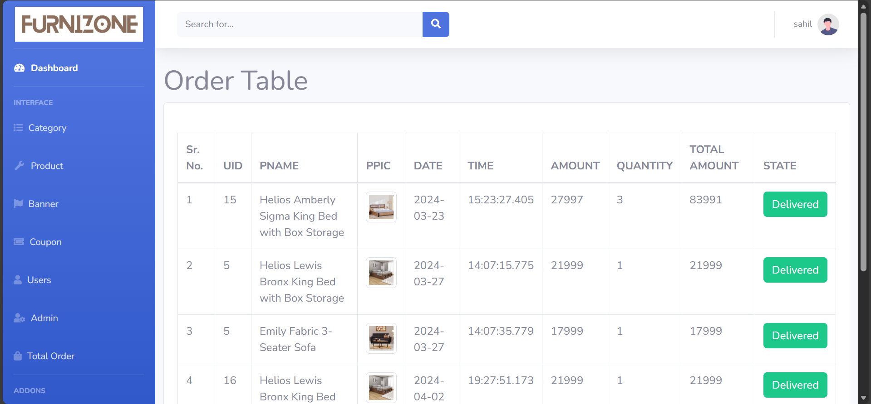
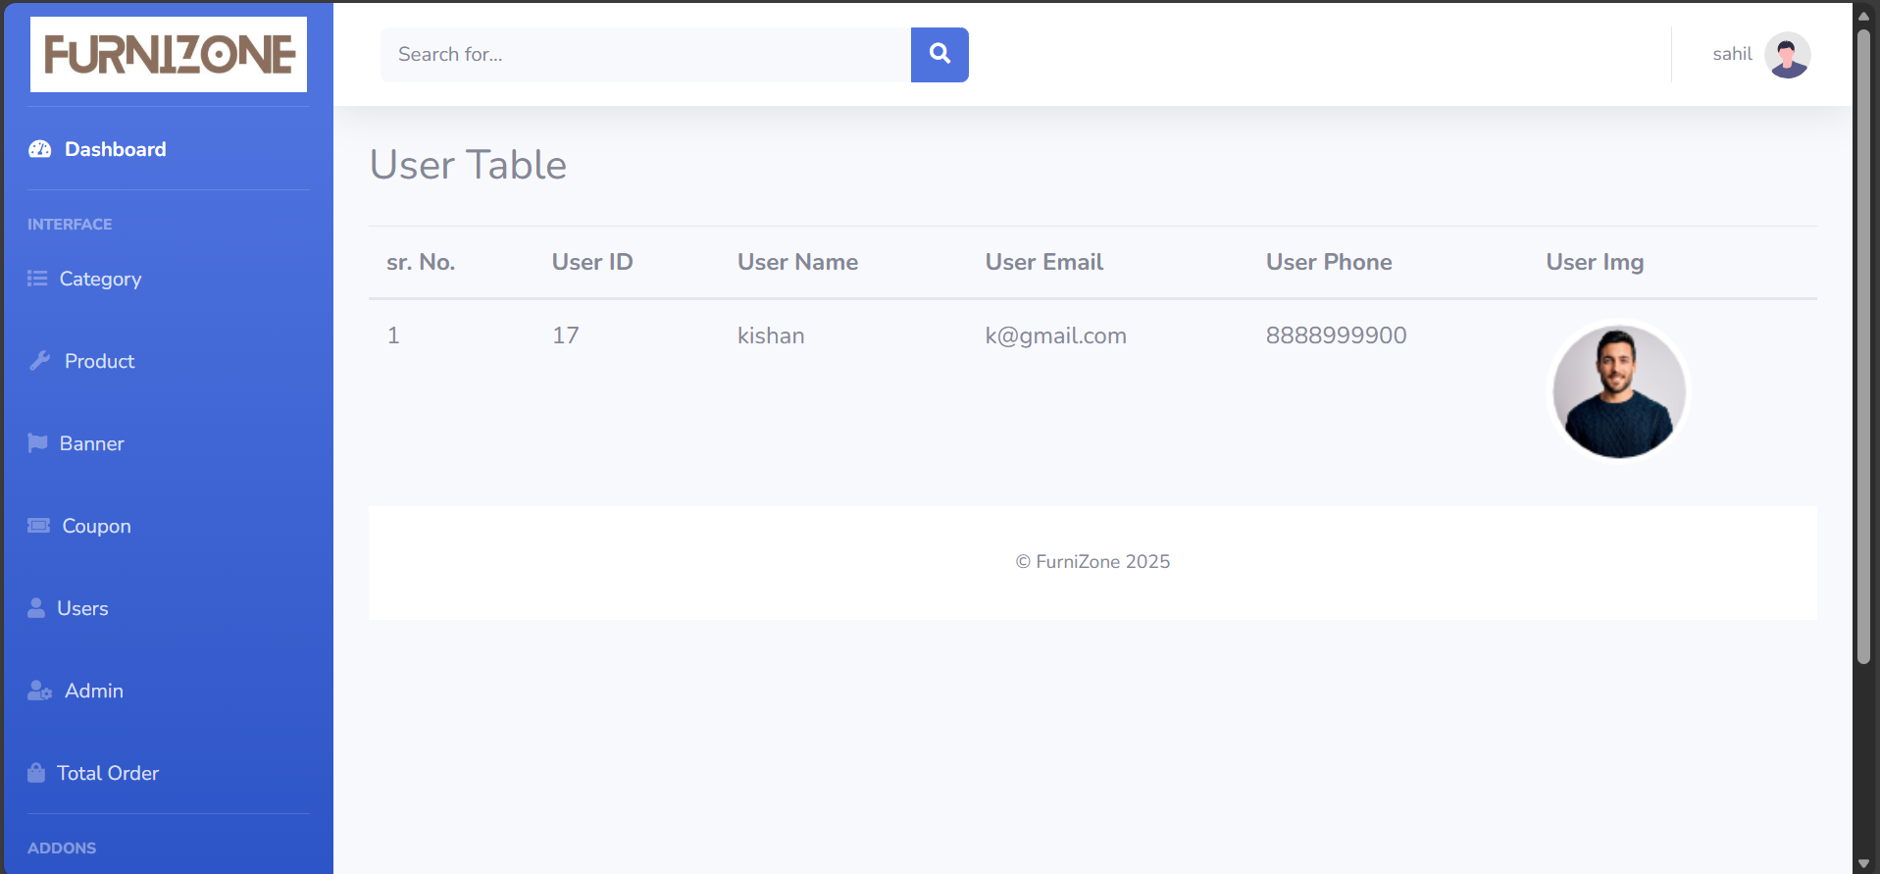
Total order and Total user
Total Order
Total User

Slide 27
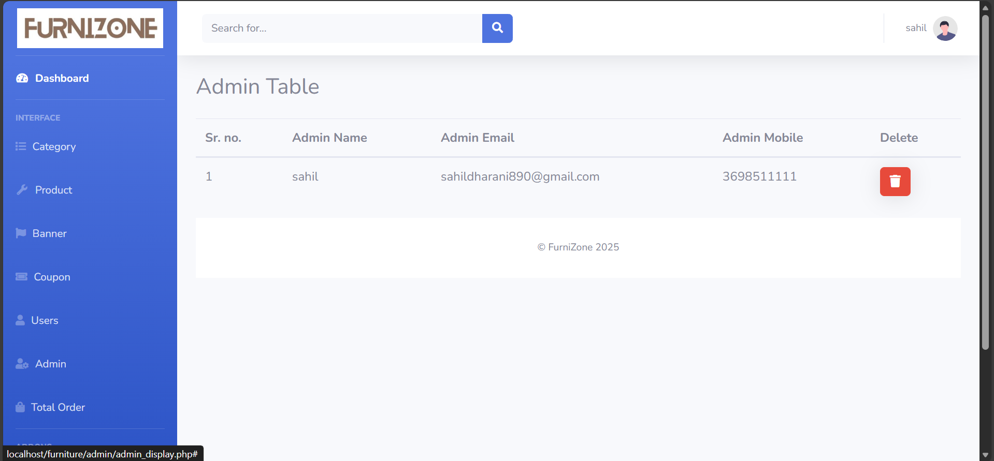

Slide 28

Customer service and support
Customer service and support in the context of furniture refers to the range of services provided by a furniture company to assist customers before, during, and after their purchase of furniture products. It encompasses various activities and interactions aimed at ensuring a positive and satisfactory experience for customers. This includes addressing inquiries, providing product information and recommendations, assisting with purchases, facilitating order tracking and delivery, handling returns and exchanges, and resolving any issues or concerns that may arise.
In essence, customer service and support in furniture involves offering attentive and responsive assistance to customers throughout their journey, from the initial browsing stage to post-purchase support. It emphasizes the importance of building and maintaining strong customer relationships by delivering high-quality service, addressing customer needs and preferences, and striving to exceed expectations in every interaction. Effective customer service and support are crucial for fostering customer satisfaction, loyalty, and advocacy, ultimately contributing to the success and reputation of the furniture company.

Slide 29


Future plans and Innovations
"Many consumers struggle to find furniture that fits their style preferences, budget constraints, and space requirements. Traditional furniture shopping experiences are often time-consuming, overwhelming, and limited by geographical constraints. As a result, customers may feel frustrated and dissatisfied with their options, leading to abandoned purchases and lost sales opportunities. Our furniture app aims to streamline the furniture shopping process by offering a curated selection of furniture items, personalized recommendations, and innovative features such as augmented reality visualization to help users make informed purchasing decisions from the comfort of their homes.".

Slide 30


References
Home center Application
ChatGPT
Youtube

